Slide 1


Module 7 – Part 2
Ps
Object-Oriented Design AND CLASS PROPERTIES

Slide 2
Topics
Default Constructors
Multiple Constructors (overloading)
Constructor “chaining”
Control of Properties
“Getters” or “Accessors”
“Setters” or “Modifiers”

Slide 3
Default Constructors
In many languages, there’s a default constructor
If you don’t create one, it’s created for you AND
IT’S INVISIBLE! AND
It takes no parameters AND
It sets variables/attributes:
To zero (0) for numbers
To FALSE for booleans
To NULL (empty) for objects like strings

Slide 4
What it would look like (if you could see it)
CLASS Dog BEGIN
CREATE rabid
CREATE weight
CREATE name
// It’s INVISIBLE!
CONSTRUCTOR Dog ( )
rabid ← false
weight ← 0
name ← NULL
END CONSTRUCTOR
END CLASS
Ps

Slide 5
Multiple Constructors (a.k.a. overloading)
We can have more than one constructor
Remember, constructors are used to initialize our objects
We can use parameters with the constructor to customize the initialization
Sometimes we have more or less data to use in the customization
We’d like to be able to pass in only what we know
8/19/20
CSE 1321 Module 6
5

Slide 6
Implementation
Overloading the constructor involves using the same method/function name
Vary the number of parameters; AND/OR
Vary the type of parameters
8/19/20
CSE 1321 Module 6
6

Slide 7
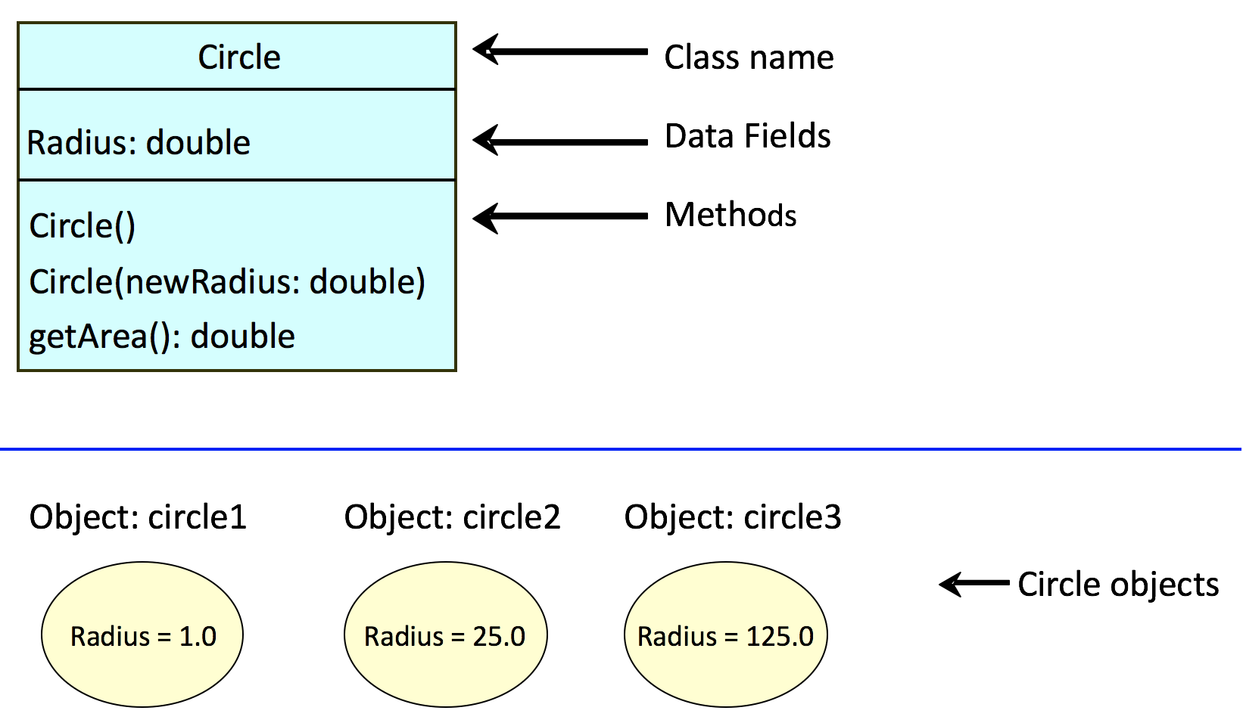
Another Example: Class Circle
8/19/20
CSE 1321 Module 6
7

Slide 8
Class Circle Pseudocode
CLASS Circle
BEGIN
CREATE Radius ← 1.0
CONSTRUCTOR Circle //called default constructor
BEGIN END CONSTRUCTOR
CONSTRUCTOR Circle (NewRadius) //called constructor
BEGIN
Radius ← NewRadius
END CONSTRUCTOR
METHOD getArea () //compute and return circle area
BEGIN
RETURN (Radius * Radius * 3.14159)
END METHOD
END CLASS
Ps
4/26/2018
CSE 1321 Module 6
5

Slide 9
Class Circle
public class Circle { double radius = 1.0; Circle() //default constructor {
} Circle(double newRadius) //another constructor { radius = newRadius; } public double getArea() //calculates area
{ return (radius*radius*3.14159); } }
6

Slide 10

// Header
class Circle {
public:
double radius;
Circle();
Circle(double newRadius);
double getArea();
};
// The implementation file – Circle.cpp
Circle::Circle() {
radius = 1.0;
}
Circle::Circle(double newRadius) {
radius = newRadius;
}
double Circle::getArea() {
return (radius*radius*3.14159);
}

Slide 11
Driver in Pseudocode
CLASS TestCircle
BEGIN
CREATE circle1, circle2 AS Circle // create two variables
circle1 ← NEW circle() // create circle1 object
circle2 ← NEW circle(25.0) // create circle2 object
PRINT ("Circle 1 area = " + circle1.getArea())
PRINT ("Circle 2 area = " + circle2.getArea())
END TestCircle
Outputs:
Circle 1 area = 3.14159 Circle 2 area = 1963.4937499999999
Ps
4/26/2018
CSE 1321 Module 6
5

Slide 12
Driver in Java
class Test_Circle {
public static void main (String args[]) { Circle c1 = new Circle();
System.out.println("The area of the c1 is " + c1.getArea());
Circle c2 = new Circle(25); System.out.println("The area of c2 is " + c2.getArea());
} }
4/26/2018
CSE 1321 Module 6
6

Slide 13
Driver in C#
class Test_Circle {
public static void Main (string args[]) { Circle c1 = new Circle();
Console.WriteLine("The area of the c1 is " + c1.getArea());
Circle c2 = new Circle(25); Console.WriteLine("The area of c2 is " + c2.getArea());
} }
4/26/2018
CSE 1321 Module 6
6

Slide 14
Driver in C++
int main() {
Circle c1;
cout << "The area of c1 is "
<< c1.getArea() << endl;
// The advanced "pointer" way
Circle* c2;
c2 = new Circle(5);
cout << "The area of c2 is "
<< c2->getArea() << endl;
}

Slide 15
Visibility of Class Content
Problem: Imagine class “Person” with an “age” attribute
Then, a “bad guy” directly sets the age to -3!
We need protection/security
We need a way of selectively “publishing” parts of a class and “hiding” other parts of the class
Use public & private keywords
8/19/20
CSE 1321 Module 6
15

Slide 16
Sloppy Definitions
public: anyone (or anything) can see it from anywhere! That is, anything outside the class.
private: can only be seen/called inside the class.
Note, variables, methods and even classes can be marked either public or private

Slide 17
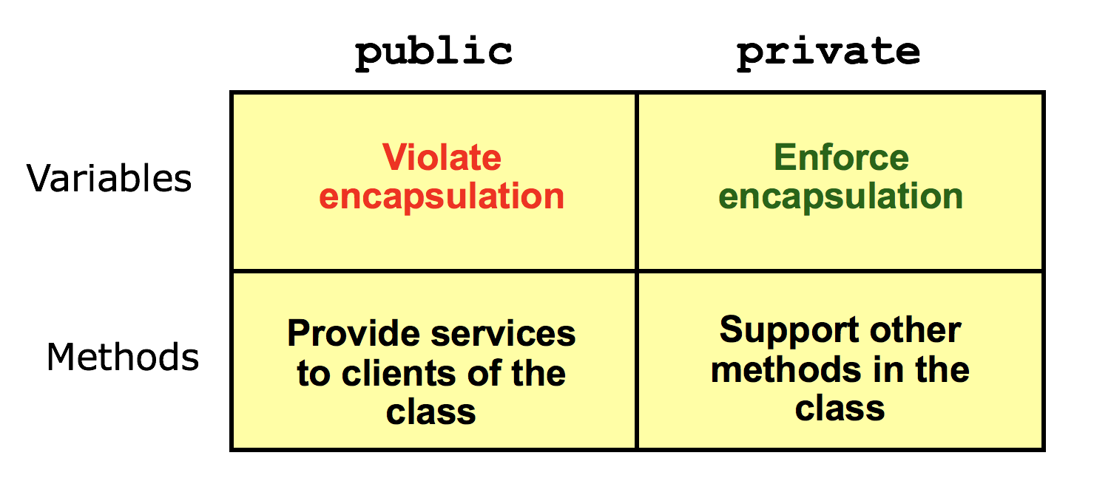
Implications of public and private (this is a bit hard to understand…)
8/19/20
CSE 1321 Module 6
17

Slide 18
General Rules
Variables/attributes are normally marked private
public variables can be tampered with and abused!
Methods are most often marked public
However, some methods should be marked as private

Slide 19
Wait! How do we change private variables?
Let’s review, shall we?

Slide 20
Public Doggies (with private lives)
PUBLIC CLASS Dog BEGIN
PRIVATE CREATE rabid // change this?
PRIVATE CREATE weight // and this?
PUBLIC CREATE name
// Boring constructor
PUBLIC CONSTRUCTOR Dog ( )
rabid ← false
weight ← 0
name ← NULL
END CONSTRUCTOR
END CLASS
Ps

Slide 21
Main idea
Use methods to access and change the variables/attributes. Instead of direct access
8/19/20
CSE 1321 Module 6
21

Slide 22
Accessors/Modifiers
These are public methods that enable change to attributes
Also called “getters” and “setters”
Why is this cool? Can put in protections to prevent bad data
PUBLIC setAge (parameter: newAge) BEGIN IF (newAge > 110) THEN age = newAge ELSE PRINT (“That’s too old!”) ENDIF END

Slide 23
Example
class Dog {
private int weight;
private boolean isRabid;
public String name;
public Dog(int w, String n) {
weight = w;
name = n;
isRabid = false;
}
public void setWeight (int w) {
if (w > 0) {weight = w;}
}
public void setRabid (String n) {name = n;}
public int getWeight () {return weight;}
public boolean getRabid() {return isRabid;}
}
6

Slide 24
Example
class Dog {
private int weight;
private bool isRabid;
public string name;
public Dog(int w, string n) {
weight = w;
name = n;
isRabid = false;
}
public int Weight { // Access Weight, not weight
get {return weight;}
set {weight = value;}
}
public bool IsRabid { // IsRabid, not isRabid
get {return isRabid;}
set {isRabid = value;}
}
}
7

Slide 25
Example
class Dog {
private:
bool isRabid;
float weight;
public:
string name;
Dog(float w, string n);
bool getRabid();
float getWeight();
void setRabid (bool r);
void setWeight (float w);
};
Dog::Dog(float w, string n) {
isRabid = false; weight = w; name = n;
}
bool Dog::getRabid() {return isRabid;}
float Dog::getWeight() {return weight;}
void Dog::setRabid(bool r) {isRabid = r;}
void Dog::setWeight(float w) {weight = w;}

Slide 26
A common point of confusion
We see a lot of keywords like this and self
What is that?
A reference to something inside the class we’re coding in
Commonly used to resolve ambiguity of variables:

Slide 27
A point of confusion
Ps
PUBLIC CLASS Dog BEGIN
PRIVATE CREATE rabid
PRIVATE CREATE weight
PUBLIC CREATE name
PUBLIC CONSTRUCTOR Dog (parameter: rabid, weight, name)
rabid ← rabid // what?
weight ← weight // huh?
name ← name // wuh?
END CONSTRUCTOR
END CLASS

Slide 28
Better
Ps
PUBLIC CLASS Dog BEGIN
PRIVATE CREATE rabid
PRIVATE CREATE weight
PUBLIC CREATE name
PUBLIC CONSTRUCTOR Dog (parameter: rabid, weight, name)
this.rabid ← rabid // assign attributes
this.weight ← weight // the parameters
this.name ← name
END CONSTRUCTOR
END CLASS
// Note – in C++, you’ll use the arrow (e.g. this->name)

Slide 29
Last thing: Constructor Chaining
It’s possible for one constructor to leverages/calls another
You can do this as many times as you want
Let’s see an example

Slide 30
Ps
PUBLIC CLASS Dog BEGIN
PRIVATE CREATE rabid
PRIVATE CREATE weight
PUBLIC CREATE name
PUBLIC CONSTRUCTOR Dog ( ) // Default constructor
// Call the constructor below
this (FALSE, 4, “Fluffy”)
END CONSTRUCTOR
PUBLIC CONSTRUCTOR Dog (parameter: rabid, weight, name)
this.rabid ← rabid
this.weight ← weight
this.name ← name
END CONSTRUCTOR
END CLASS

Slide 31
Summary
A class is made of variables and methods.
Variables represent the state of the class objects;
Variables should (almost) always be declared private
Method provide controlled access to variables
Methods intended for class client should be public.
Other methods for local use should be private.
Controlled access to the variables promotes encapsulation.

